Slide 1
Sql vs Neo4j
Anju munoth

Slide 2
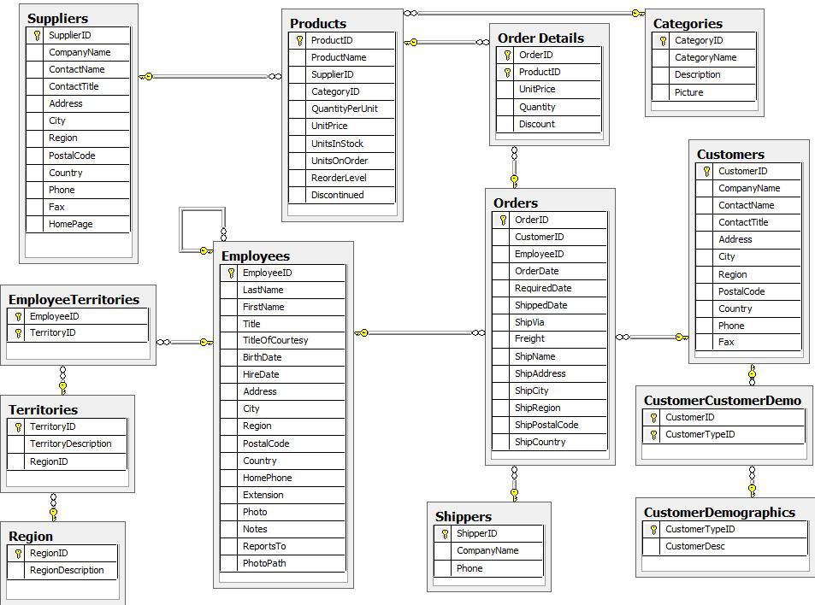

Slide 3
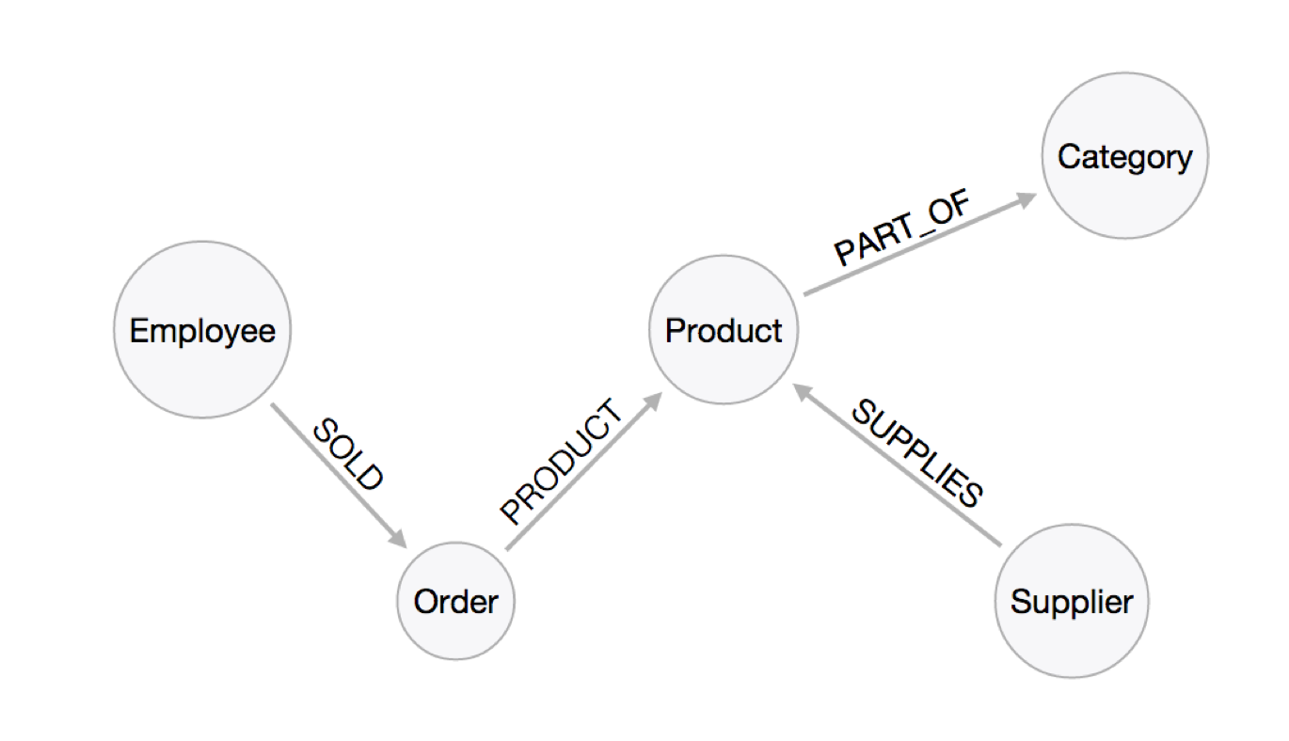
Graph Model

Slide 4
Find all Products
Relational Model
SELECT p.* FROM products as p;
Graph Model
MATCH (p:Product) RETURN p;

Slide 5
Field Access, Ordering and Paging
Relational Model
SELECT p.ProductName, p.UnitPrice FROM products as p ORDER BY p.UnitPrice DESC LIMIT 10;
Graph Model
MATCH (p:Product) RETURN p.productName, p.unitPrice ORDER BY p.unitPrice DESC LIMIT 10;

Slide 6
Find single Product by Name
Relational Model
SELECT p.ProductName, p.UnitPrice FROM products AS p WHERE p.ProductName = 'Chocolade';
Graph Model
MATCH (p:Product) WHERE p.productName = "Chocolade" RETURN p.productName, p.unitPrice;

Slide 7
Filter Products
Relational Model
SELECT p.ProductName, p.UnitPrice FROM products as p WHERE p.ProductName IN ('Chocolade','Chai’);
SELECT p.ProductName, p.UnitPrice FROM products AS p WHERE p.ProductName LIKE 'C%' AND p.UnitPrice > 100;
Graph Model
MATCH (p:Product) WHERE p.productName IN ['Chocolade','Chai'] RETURN p.productName, p.unitPrice;
MATCH (p:Product) WHERE p.productName STARTS WITH "C" AND p.unitPrice > 100 RETURN p.productName, p.unitPrice;

Slide 8
Joining Products with Customers
Relational Model
SELECT DISTINCT c.CompanyName FROM customers AS c JOIN orders AS o ON (c.CustomerID = o.CustomerID) JOIN order_details AS od ON (o.OrderID = od.OrderID) JOIN products AS p ON (od.ProductID = p.ProductID) WHERE p.ProductName = 'Chocolade';
Graph Model
MATCH (p:Product {productName:"Chocolade"})<-[:PRODUCT]-(:Order)<-[:PURCHASED]-(c:Customer) RETURN distinct c.companyName;

Slide 9
New Customers without Orders yet
Relational Model
SELECT p.ProductName, sum(od.UnitPrice * od.Quantity) AS Volume FROM customers AS c LEFT OUTER JOIN orders AS o ON (c.CustomerID = o.CustomerID) LEFT OUTER JOIN order_details AS od ON (o.OrderID = od.OrderID) LEFT OUTER JOIN products AS p ON (od.ProductID = p.ProductID) WHERE c.CompanyName = 'Drachenblut Delikatessen' GROUP BY p.ProductName ORDER BY Volume DESC;
Graph Model
MATCH (c:Customer {companyName:"Drachenblut Delikatessen"}) OPTIONAL MATCH (p:Product)<-[pu:PRODUCT]-(:Order)<-[:PURCHASED]-(c) RETURN p.productName, toInteger(sum(pu.unitPrice * pu.quantity)) AS volume ORDER BY volume DESC;

Slide 10
Top-Selling Employees
Relational Model
SELECT e.EmployeeID, count(*) AS Count FROM Employee AS e JOIN Order AS o ON (o.EmployeeID = e.EmployeeID) GROUP BY e.EmployeeID ORDER BY Count DESC LIMIT 10;
Graph Model
MATCH (:Order)<-[:SOLD]-(e:Employee) RETURN e.name, count(*) AS cnt ORDER BY cnt DESC LIMIT 10

Slide 11
Return territory information for each employee.
Relational Model
SELECT e.LastName, et.Description FROM Employee AS e JOIN EmployeeTerritory AS et ON (et.EmployeeID = e.EmployeeID) JOIN Territory AS t ON (et.TerritoryID = t.TerritoryID);
Graph Model
MATCH (t:Territory)<-[:IN_TERRITORY]-(e:Employee) RETURN t.description, collect(e.lastName);

